Slide 1
Court Data Innovation in Hamilton County
A Partnership between the General Sessions Courts and Georgetown Law
Kat Albrecht | JD, PhD

Slide 2
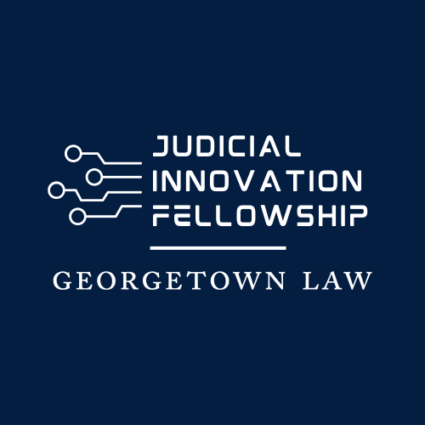
Origins of the Project
“The Judicial Innovation Fellowship (JIF) is a fellowship for technology industry professionals to transform justice across state, local, territorial, and tribal courts.”
“The Hamilton County General Sessions Court and the county government want to assess what data their courts have, where the data lives, what format the data is in, and to understand collection and sharing practices”
Kat Albrecht | JD, PhD

Slide 3
Introduction
Professor at Georgia State University in Criminal Justice and Criminology
Director of the Fear and Computational Law Lab
North American Director of the Summer Institutes in Computational Social Science
Computer scientist and data infrastructure specialist
Kat Albrecht | JD, PhD

Slide 4
Project Flow
Phase 1: Researching the county and county courts’ data systems, use, culture
Phase 2: Synthesize research and begin formulating, sharing, and iterating potential recommendations.
Phase 3: Document research and recommendations for future work and implementation. Provide handoff training to permanent county and court staff
Kat Albrecht | JD, PhD

Slide 5
Phase 1
Interviewed, shadowed, or observed:
Courts (General Sessions, District, Juvenile, civil, criminal)
Bench clerks
Clerks in various data functions (the annex, entering data, etc.)
Judge’s office
Municipal courts (East Ridge, Collegedale, Soddy-Daisy, Signal Mtn., Red Bank)
IT
Sheriff’s office
DA’s office
Jail deputies
Recovery court
Defense attorneys
Judges
Data innovation employees
Legal aid groups
Community groups
Court administrative workers
Chattanooga Police Department
Kat Albrecht | JD, PhD

Slide 6
Synthesizing Research & Sharing Recommendations
Data Innovation Steering Committee
Data Innovation Advisory Committee
Identifying key areas of innovation success across the county
The arrest – imaging pipeline
Juvenile Court
A feature rich Case Management System
Kat Albrecht | JD, PhD

Slide 7
Court Data Innovation in Hamilton County
The report
Kat Albrecht | JD, PhD

Slide 8
Report Structure
The Current Culture of Data Innovation in Hamilton County
A Snapshot of County Data
Error Checking and System Access
The Case for Documentation
Cross-Unit Communication
Easy Fixes vs. Major Lifts
County Data Outside the County
Working with Vendors
Looking Towards the Future
Kat Albrecht | JD, PhD

Slide 9
Report Structure
The Current Culture of Data Innovation in Hamilton County
A Snapshot of County Data
Error Checking and System Access
The Case for Documentation
Cross-Unit Communication
Easy Fixes vs. Major Lifts
County Data Outside the County
Working with Vendors
Looking Towards the Future
Introduction & context
Analytic themes with paired recommendations
Conclusions & future
Kat Albrecht | JD, PhD

Slide 10
Short-term and Long-term Recommendations
Develop policies around data access, error resolution, and documentation
Refresh the CJUS interface taking on board user feedback
Take a cross-unit systems approach to data infrastructure
Kat Albrecht | JD, PhD

Slide 11
Data Policies
Key Recommendations: Build norms for documentation of training procedures, databases, data structures, and policies, collect these in a repository or entrust to a Data Systems Specialist
Kat Albrecht | JD, PhD

Slide 12
Data Policies
Key Recommendations: Build norms for documentation of training procedures, databases, data structures, and policies, collect these in a repository or entrust to a Data Systems Specialist
Next Steps: Georgetown law students conduct research and draft preliminary policies
Kat Albrecht | JD, PhD

Slide 13
CJUS Refresh
Key Recommendations: Refresh the user interfaced of CJUS, continued investment in the structure of CJUS
Next Steps: Work with USDR, IT is internally prioritizing structure and storage
Kat Albrecht | JD, PhD

Slide 14
Cross-Unit Systems Approach
Key Recommendations: Build on existing initiatives like Hamilton Counted, appoint individuals within units as liaisons with IT, a Data Systems Specialist to share compliance information and take a macro-approach to data infrastructure
Benefits: Saves money, reduces errors both in justice administration and in court
Kat Albrecht | JD, PhD

Slide 15
Cross-Unit Systems Approach
Key Recommendations: Build on existing initiatives like Hamilton Counted, appoint individuals within units as liaisons with IT, a Data Systems Specialist to share compliance information and take a macro-approach to data infrastructure
Kat Albrecht | JD, PhD

Slide 16
Thank you!
Kat Albrecht | JD, PhD

