Slide 1
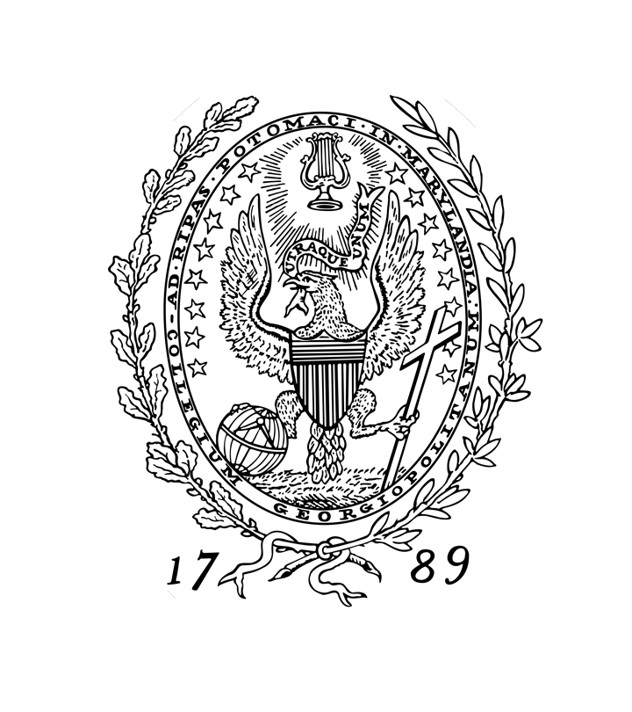
California Legal Market
Georgetown
2022
Amber Handman

Slide 2
What’s Happened to Law Firms Since The Coronavirus Began?
www.seltzerfontaine.com

Slide 3
Housing Price Comparison
 | National | California
2014 | $223,000 | $425,000
2015 | $235,000 | $454,000
2016 | $248,000 | $483,000
2017 | $264,000 | $520,000
2018 | $278,000 | $550,000
2019 | $287,000 | $558,000
2020 | $314,000 | $612,000
2021 | $377,000 | $734,000
(Zillow, March 2022)
www.seltzerfontaine.com

Slide 4
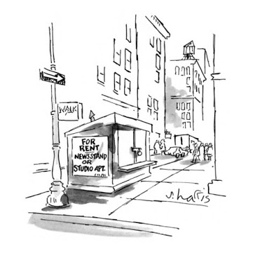
Most Expensive U.S. Cities for Renters
1 | New York
2 | San Francisco
3 | Boston
4 | San Jose
5 | Miami
6 | Washington, D.C.
7 | Los Angeles
8 | San Diego
9 | Oakland
10 | Scottsdale, AZ
(Zumper, March 2022)
www.seltzerfontaine.com

Slide 5
Cost of Living Comparison to New York City BigLaw
City | Salary Required to Yield NYC Buying Power
New York | $215,000
San Francisco | $221,728
Silicon Valley | $200,302
Los Angeles | $168,097
Orange County | $161,868
San Diego | $160,828
(Salary.com, March 2022)
www.seltzerfontaine.com

Slide 6
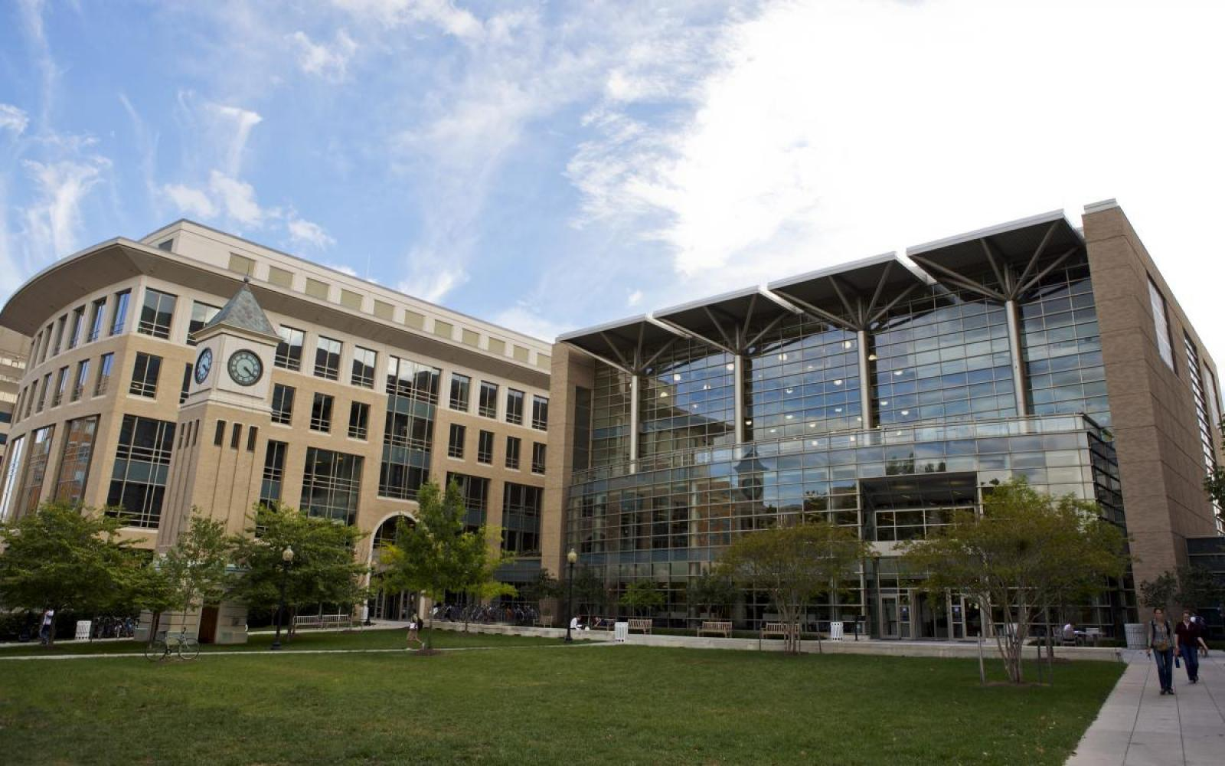
Trends
Nationalization
Consolidation
Student/New Lawyer Trends
Law Firm Trends
Diversity Trends
Mental Health
Office Trends
www.seltzerfontaine.com

Slide 7
BigLaw Salary Structure
Class Year | 2022 Base Salary | 2021 Spring Bonus | 2021 Fall Bonus | 2021 Year End Bonus | 2021 Special Bonus | Total Possible Compensation in 2022*
Class of 2021 | $215,000 | N/A | N/A | $15,000 (prorated) | N/A | $230,000 (prorated)
Class of 2020 | $225,000 | $4,500 | $7,500 | $20,000 | $4,000 | $261,000
Class of 2019 | $250,000 | $6,000 | $10,000 | $30,000 | $6,000 | $302,000
Class of 2018 | $295,000 | $12,000 | $20,000 | $57,500 | $11,500 | $396,000
Class of 2017 | $345,000 | $16,500 | $27,500 | $75,000 | $15,000 | $479,000
Class of 2016 | $370,000 | $19,500 | $32,500 | $90,000 | $18,000 | $530,000
Class of 2015 | $400,000 | $22,200 | $37,000 | $105,000 | $21,000 | $585,200
Class of 2014 | $415,000 | $24,000 | $40,000 | $115,000 | $23,000 | $617,000
*Assuming that nothing changes, though it almost always does.
www.seltzerfontaine.com

Slide 8
Number of California Partners Elevated for the Past Five Years at Select Firms
Firm | 2022 | 2021 | 2020 | 2019 | 2018
Cooley | 28 | 16 | 2 | 8 | 8
Gibson Dunn | 27 | 20 | 6 | 4 | 3
Morrison & Foerster | 22 | 9 | 8 | 3 | 5
O’Melveny | 13 | 6 | 1 | 4 | 2
Pillsbury | 13 | 11 | 4 | 2 | 2
Sheppard Mullin | 24 | 13 | 21 | 11 | 8
Wilson Sonsini | 23 | 15 | 11 | 13 | 10
www.seltzerfontaine.com

Slide 9
Profits Per Partner 2021 Select CA Firms
Firm Profits Per Partner
Kirkland & Ellis $6,194,000
Quinn Emanuel $4,669,000
Latham & Watkins $4,520,000
Gibson Dunn $4,125,000
Paul Hastings $3,903,000
Irell & Manella $3,348,000
Akin Gump $3,023,000
O’Melveny $2,456,000
Morrison & Foerster $2,240,000
Greenberg Traurig $1,913,000
(The American Lawyer, September 2021)
www.seltzerfontaine.com

Slide 10
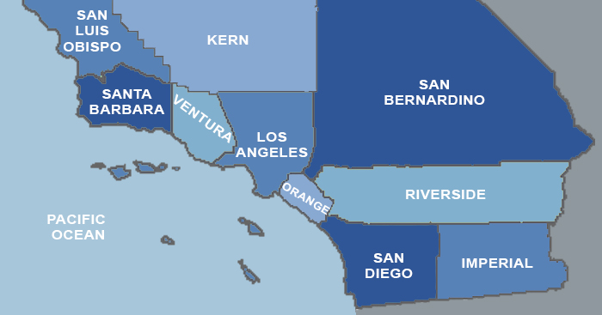
Southern California Law Firm Market
Southern California firm geography:
Los Angeles/Orange County/San Diego
www.seltzerfontaine.com

Slide 11
Largest Los Angeles Firms
Rank | Firm | Attorneys
1 | Lewis Brisbois | 319
2 | Sheppard Mullin | 267
3 | Latham & Watkins | 245
4 | Gibson Dunn | 243
5 | O’Melveny | 239
6 | Kirkland & Ellis | 182
7 | Gordon & Rees | 163
8 | Seyfarth Shaw | 154
9 | Loeb & Loeb | 147
10 | Munger | 142
(Firm Prospects, March 2022)
www.seltzerfontaine.com

Slide 12
Largest Orange County Firms
Rank | Firm | Attorneys
1 (tie) | Knobbe Martens | 135
1 (tie) | Rutan & Tucker | 135
2 | Sheppard Mullin | 81
3 | Gibson Dunn | 75
4 | Bremer Whyte | 74
5 | Latham & Watkins | 73
6 | Lewis Brisbois | 70
7 | Stradling | 69
8 (tie) | Snell & Wilmer | 59
8 (tie) | Buchalter | 59
(Firm Prospects, March 2022)
www.seltzerfontaine.com

Slide 13
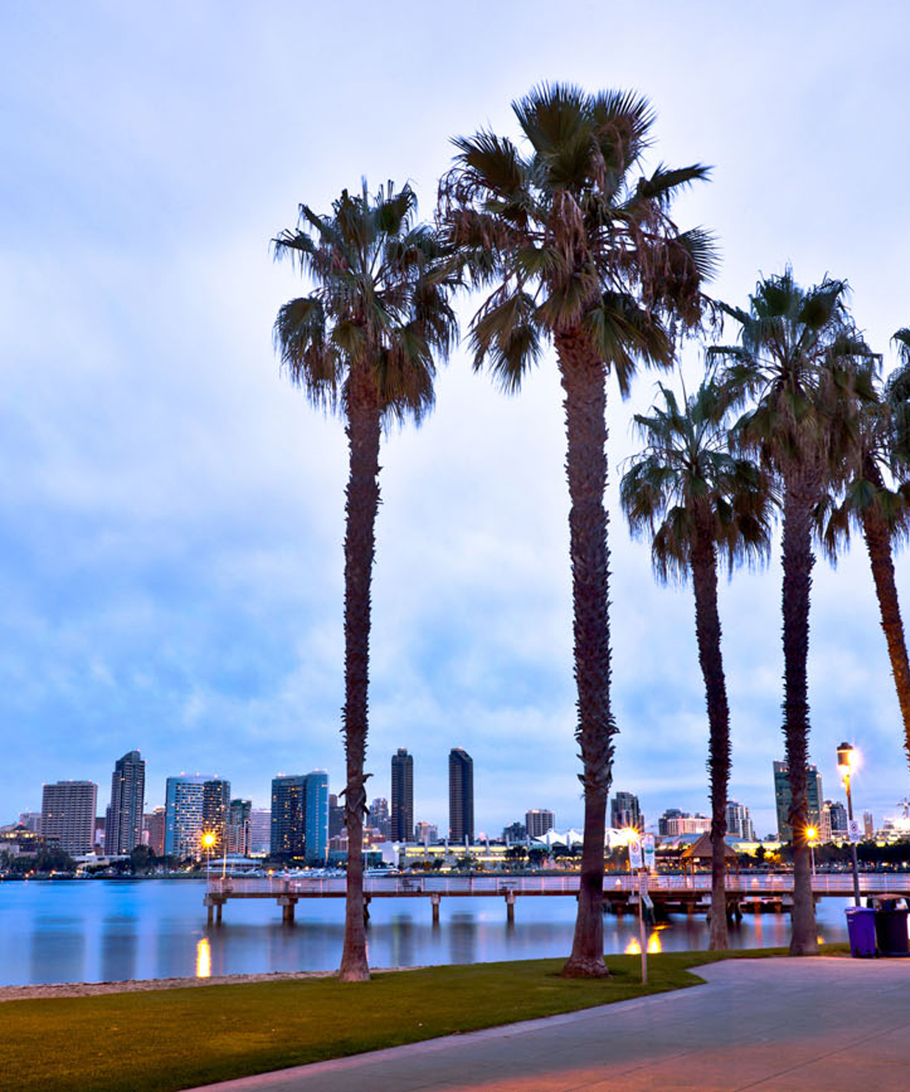
Largest San Diego Firms
Rank | Firm | Attorneys
1 | Sheppard Mullin | 163
2 | Procopio | 150
3 | Gordon & Rees | 148
4 | Cooley | 110
5 | DLA Piper | 103
6 | Latham & Watkins | 101
7 | Robbins Geller | 96
8 | Wilson Sonsini | 72
9 | Higgs Fletcher | 69
10 (tie) | Jones Day | 53
10 (tie) | Lewis Brisbois | 53
(Firm Prospects, March 2022)
www.seltzerfontaine.com

Slide 14
Southern California Firsthand (Formerly Vault) Rankings of Best Law Firms
Rank | Firm | SoCal Attorneys | SoCal Offices
1 | Latham & Watkins | 418 | LA(2), OC, SD
2 | Gibson Dunn | 332 | LA(2), OC
3 | O’Melveny | 295 | LA(2), OC
4 | Munger | 142 | LA
5 | Skadden | 59 | LA
6 | Kirkland & Ellis | 182 | LA(2)
7 | Quinn Emanuel | 125 | LA
8 | Paul Hastings | 152 | LA(2), SD
9 | Irell & Manella | 80 | LA, OC
10 | Morrison & Foerster | 110 | LA, SD
www.seltzerfontaine.com

Slide 15
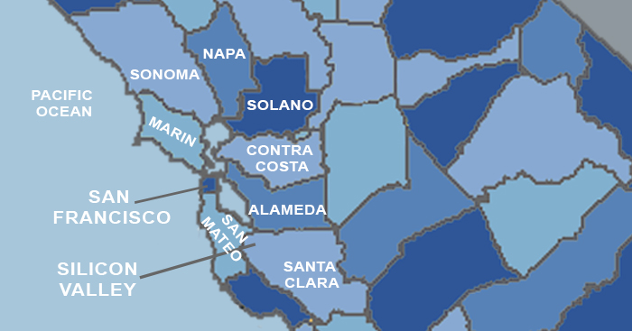
Northern California Law Firm Market
Northern California firm geography:
San Francisco/Silicon Valley
www.seltzerfontaine.com

Slide 16
Largest San Francisco Firms
Rank | Firm | Attorneys
1 | Orrick | 185
2 | Morrison & Foerster | 184
3 | Kirkland & Ellis | 177
4 | Cooley | 153
5 | Hanson Bridgett | 149
6 | Latham & Watkins | 139
7 | Wilson Sonsini | 136
8 | Farella Braun | 124
9 | Gordon & Rees | 123
10 | Morgan Lewis | 121
(Firm Prospects and firm websites, March 2022)
www.seltzerfontaine.com

Slide 17
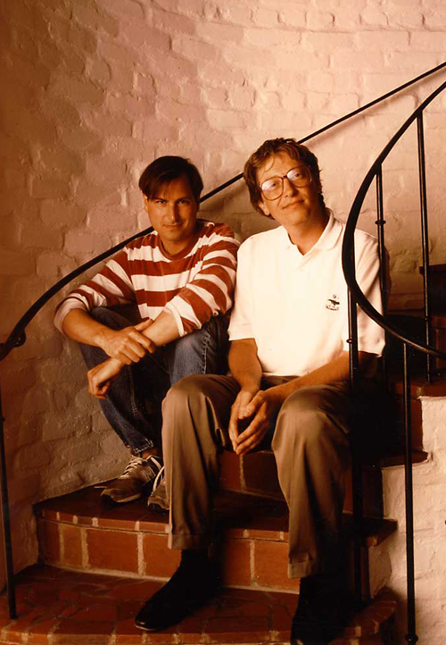
Largest Silicon Valley Firms
Rank | Firm | Attorneys
1 | Wilson Sonsini | 326
2 | Cooley | 226
3 | Fenwick & West | 155
4 | Gunderson Dettmer | 112
5 | Goodwin Procter | 107
6 | Simpson Thacher | 85
7 | DLA Piper | 76
8 | Orrick | 71
9 | Latham & Watkins | 68
10 | Morrison & Foerster | 67
(Firm Prospects, March 2022)
www.seltzerfontaine.com

Slide 18
Northern California Firsthand (Formerly Vault) Rankings of Best Law Firms
Rank | Firm | NorCal Attorneys | NorCal Offices
1 | Cooley | 375 | SF, SV
2 | Morrison & Foerster | 247 | SF, SV
3 | Wilson Sonsini | 462 | SF (2), SV
4 | Fenwick & West | 270 | SF, SV
5 | Latham & Watkins | 208 | SF, SV
6 | Orrick | 281 | SF, SV, SAC
7 | Kirkland & Ellis | 200 | SF, SV
8 | Skadden | 67 | SV
9 | Gibson Dunn | 139 | SF, SV
10 | Quinn Emanuel | 95 | SF, SV
www.seltzerfontaine.com

Slide 19
California Hiring and Practice Trends: What’s Hot and What’s Not
Smoking Hot: Corporate
Hot: Litigation, IP, Employment, Real Estate
Warm: Privacy/Cybersecurity, Banking & Finance, Healthcare
Cold: Environment/Energy, Bankruptcy, Tax, International
Emerging Practice Areas
www.seltzerfontaine.com

Slide 20
Associate Positions at SeltzerFontaine: Southern California
www.seltzerfontaine.com

Slide 21
Associate Positions at SeltzerFontaine:
Northern California
www.seltzerfontaine.com

Slide 22
Current Associate Positions at
SeltzerFontaine
www.seltzerfontaine.com

Slide 23
Entertainment Practice: a Special Case
What is it?
How to break in
Firms
www.seltzerfontaine.com

Slide 24
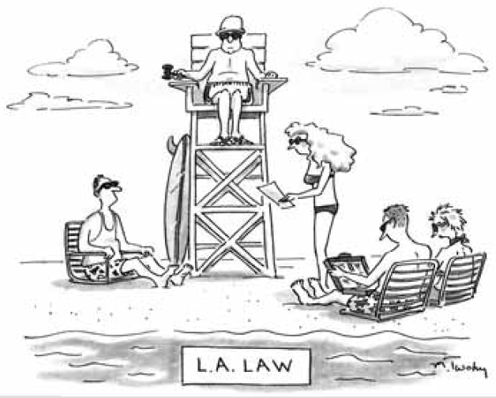
Choices: Who’s Coming or Not Coming to Georgetown
OCI stats
NALP stats
Firms with OCI programs and CA summer programs but who are not coming to Georgetown
Some other firms to know about
Firms with new CA offices
www.seltzerfontaine.com

Slide 25
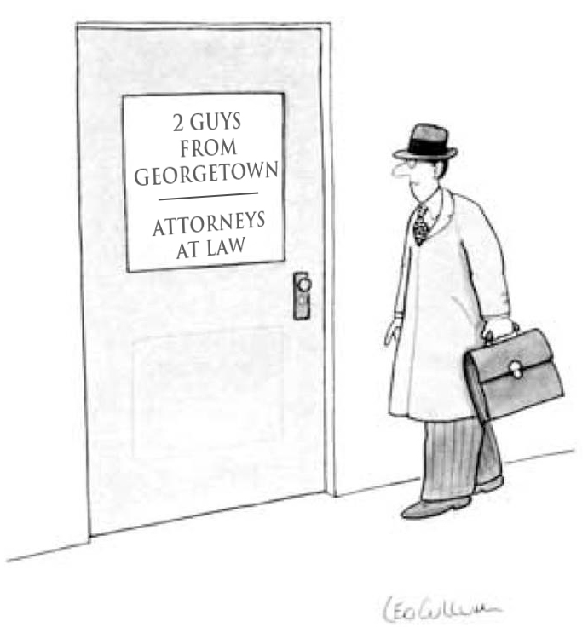
Georgetown Law Graduates in California
City | Number of Alumni
Los Angeles | 718
San Francisco | 562
Silicon Valley | 254
San Diego | 184
Orange County | 175
Sacramento | 55
(Martindale-Hubbell, March 2022)
www.seltzerfontaine.com

Slide 26
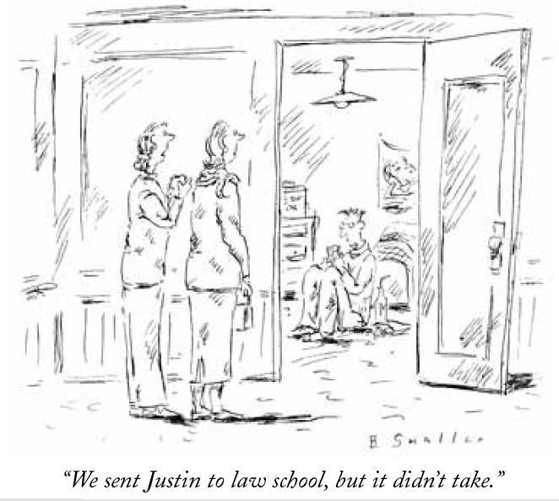
Landing a Job in California
Attend job fairs
NALP/Martindale-Hubbell
Contact Georgetown grads in CA
Use undergrad connections
Professors with California connections
Local bar associations
www.seltzerfontaine.com

Slide 27
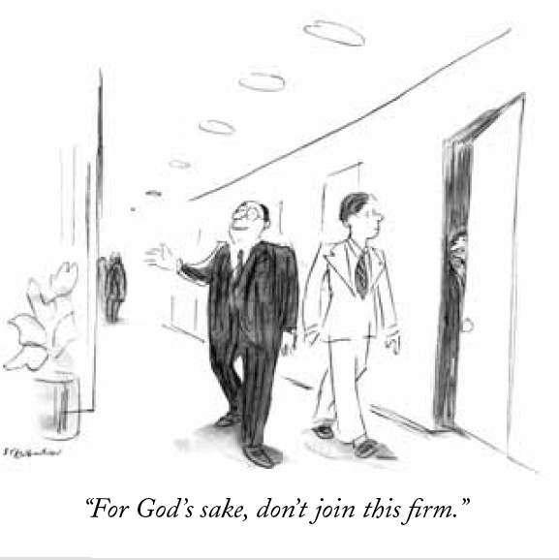
Closing Thoughts
Show a commitment to California
Take the CA Bar sooner rather than later
www.seltzerfontaine.com

Slide 28
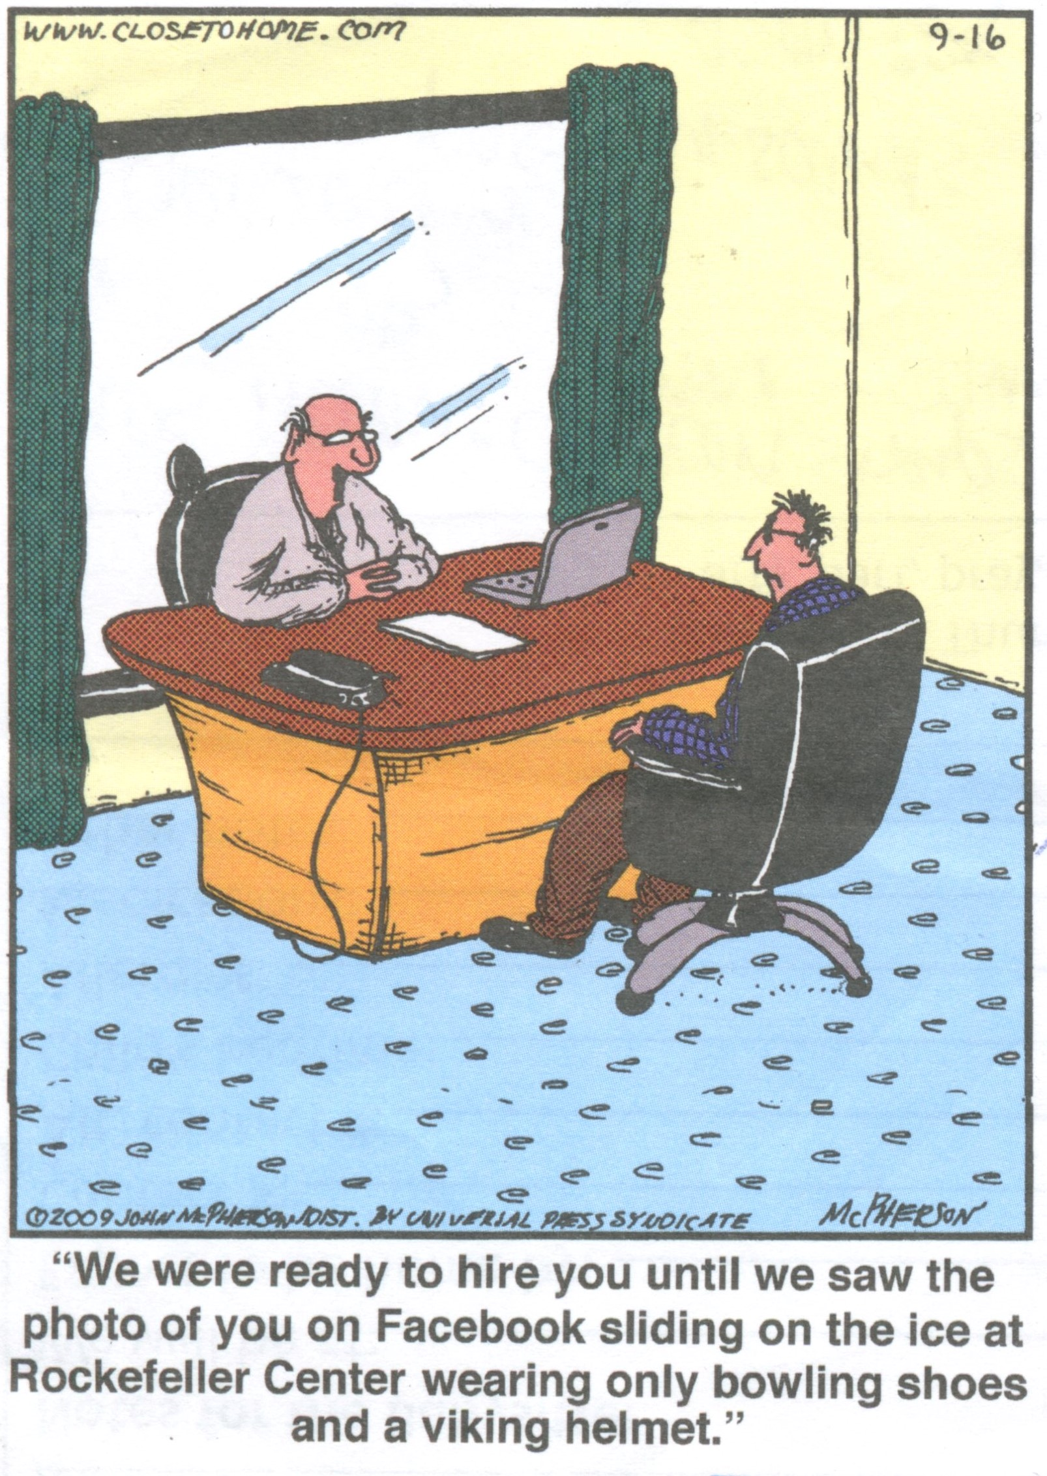
More Closing Thoughts
Academic performance
Control your social media
Career planning
www.seltzerfontaine.com

Slide 29
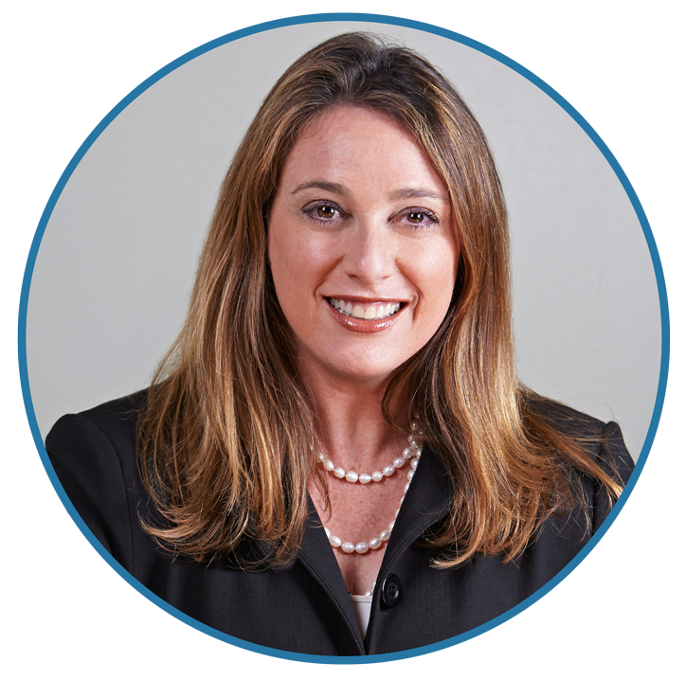
Amber Handman
ahandman@seltzerfontaine.com
(310) 842-6989
www.seltzerfontaine.com
www.seltzerfontaine.com

